Slide 1
Working with OAuth
Robert Crooks
http://files.brightcove.com/oauth-exercises.zip

Slide 2
What is Oauth 2.0
Standard authentication system for RESTful APIs
Used by Google, Twitter, etc.
Used for all Brightcove’s new RESTful APIs

Slide 3
How does it work?
There are several OAuth “flows”
Customers will generally use the Client Credential flow
OAuth Service server-side calls (client-side for Studio modules only)
How it works:
You get client credentials for some combination of API operations
Use the OAuth UI or make an API call
The credentials are a client_id and client_secret
You use the client_id and client_secret to get an access_token from the OAuth service
access_tokens time out (currently in 5 minutes)
The access_token is used to authenticate the API call

Slide 4
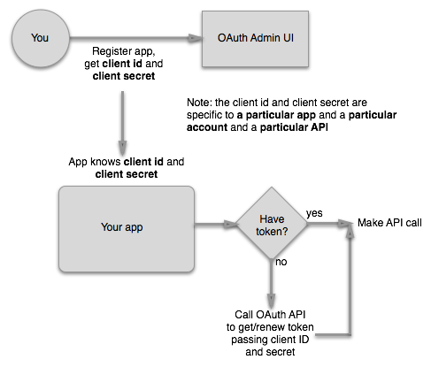
Client Credential Flow
This is the basic logic for using Oauth with your apps. If the API operations you need are not in the OAuth UI, you can also get them via the OAuth API (Exercise 1)

Slide 5
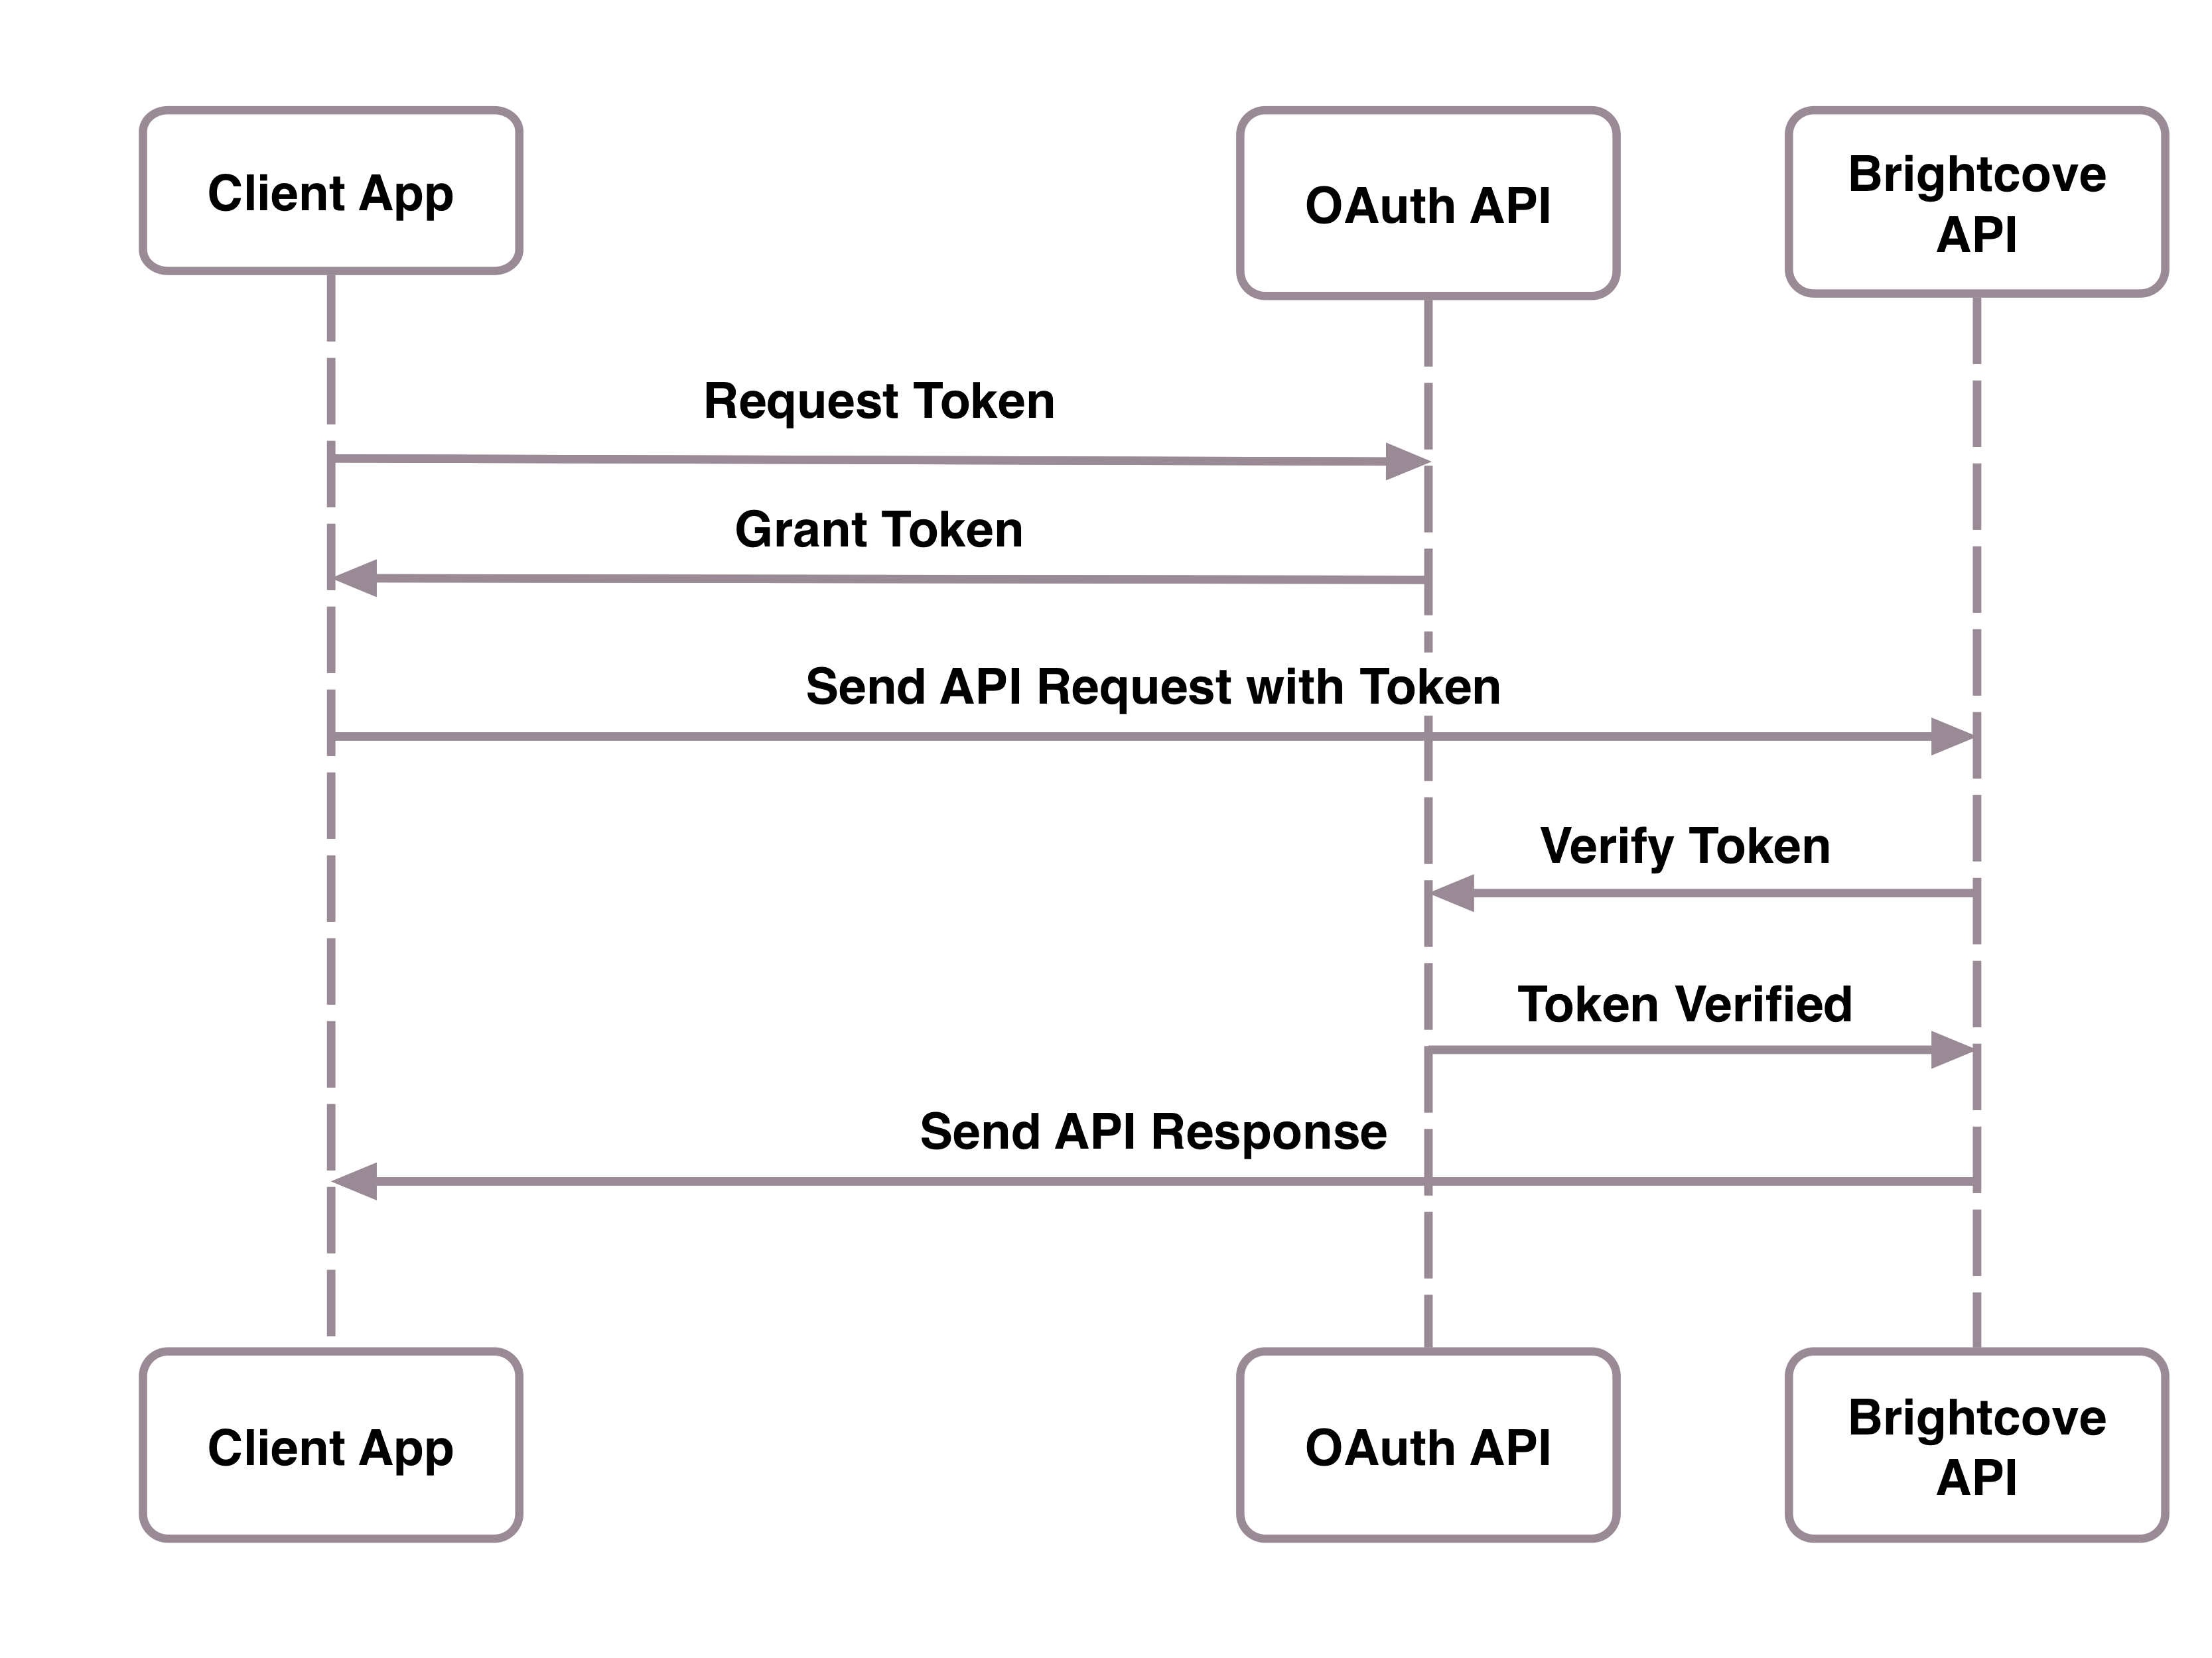
Sequence Diagram: One App
If you just building one app, build the logic for getting tokens into the app

Slide 6
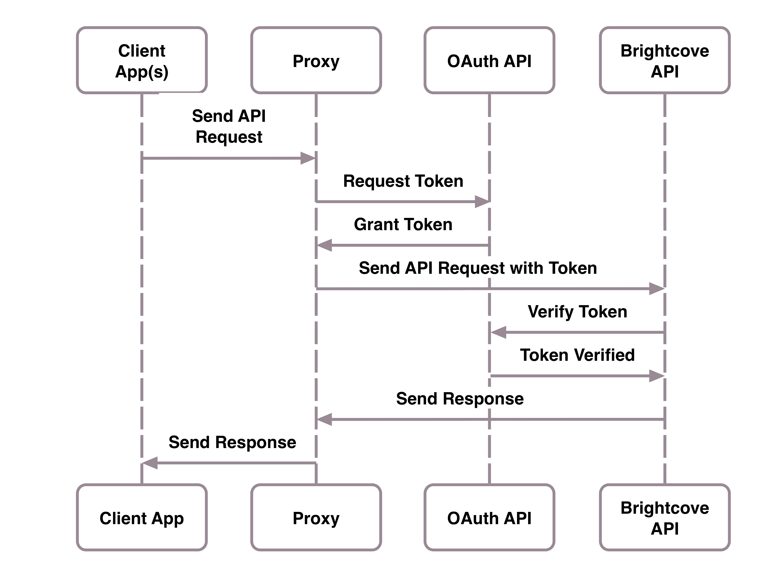
Sequence Diagram: Multiple Apps
If you are going to create multiple apps (or a client-side web app) that will access an API, centralize the logic for getting access tokens in one place; one way to do this is to build a proxy for the API calls.
The proxy could be a separate service or an embedded library. Note that there are several 3rd party libraries for OAuth2: http://oauth.net/2/

Slide 7
API Call to Get Client Credentials
API call
https://oauth.brightcove.com/v3/client_credentials
Headers
Authorizaton: BC_TOKEN your_bc_token
Content-Type: application/x-www-form-urlencoded
Request body
name=SampleClient&maximum_scope=[{
"identity": {
"type": "video-cloud-account”,
"account-id": YOUR_ACCOUNT_ID
},
"operations": [
"video-cloud/video/all”
]
}]

Slide 8
API Call to Get Access Token
API call
https://oauth.brightcove.com/v3/access_token
Headers
Authorizaton: Basic client_id:client_secret (base64 encoded)
Content-Type: application/x-www-form-urlencoded
Request body
grant_type=client_credentials

Slide 9
Exercise 1
Get Client Credentiasl

Slide 10
Setup
Access to the OAuth UI in Studio
But note that not all API operations are there yet
Alternatively, make an API call to the OAuth API
You will need your BC_TOKEN
You will also need the operations you want access to
Get the BC_TOKEN from browser cookies
You must be in Studio
You must be in the account you want to use the API on
Save the client_id and client_secret where you can find them!

Slide 11
Hands-on: Get Client Credentials
In this exercise, we will make a call to the OAuth API to get client credentials for the CMS API
What you will need:
Files for the exercises: http://files.brightcove.com/oauth-exercises.zip
A browser to access Studio
Ability to run CURL commands (native on Macs; for Windows, you can get these tools by installing cygwin. During the install you will be prompted for packages to install. Open the Net package, then check the curl option and then finish the installation.)

Slide 12
Get Your BC_TOKEN
Login to Brightcove Studio
Open the Developer Console in your browser
Paste the following lines of JavaScript at the console prompt and press Return (this code is in JavaScript.js):
var cookiesArray = document.cookie.split(";"), cookiesObj = {}, i, tmpArray = [];
for (i = 0; i < cookiesArray.length; i++) {
tmpArray = cookiesArray[i].split("=");
cookiesObj[tmpArray[0].replace(/\s/g, "")] = tmpArray[1];
}
window.prompt("BC_TOKEN:", cookiesObj.BC_TOKEN);
You should see your BC_TOKEN cookie appear in a popup dialog; copy and save it for the next step.

Slide 13
Get Your Access Credentials
Go to a command line and paste in the following CURL command (the code is in curl.txt):
curl \
--include \
--header "Authorization: BC_TOKEN Your_BC_TOKEN_HERE" \
--data 'name=SampleClient&maximum_scope=[{
"identity": {
"type": "video-cloud-account",
"account-id": YOUR_ACCOUNT_ID
},
"operations": [
"video-cloud/video/all"
]
}]' \
https://oauth.brightcove.com/v3/client_credentials
Copy the client_id and client_secret and save them for use in the next exercise.

Slide 14
Exercise 2
Make an API Call

Slide 15
Setup
For this exercise, we will make a CMS API call from a web page, using the client credentials we got in the previous exercise
Since we can’t call the OAuth API directly from our local web server, we’ll route the call through a proxy that Learning Services built: http://solutions.brightcove.com:8006/
The file we will work in is /oauth-exercises/oauth-exercise.html
You need to save this file somewhere under the document root of your local web server

Slide 16
Add the Proxy Call to Make the API Request
Open the oauth-exercise.html file in your editor
Open the send-request.js file in your editor
Copy the contents of the send-request.js file and paste them into the submitRequest() function in the oauth-exercise.html file
Save the oauth-exercise.html and browse it through your local web server:
http://localhost/{path}/oauth-exercise.html

Slide 17
Thank you
All materials used in the session are available at https://github.com/BrightcoveLearning/Oauth-API-Training

